Slide 1
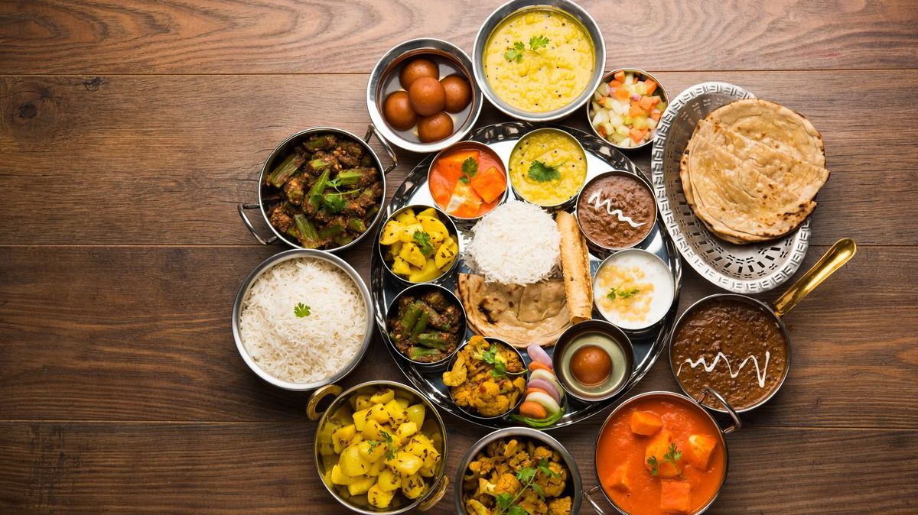
A Complete guide to Indian food in the US
Prepared for Coursera Capstone Data Science Course by
Mayank Pandey

Slide 2
Introduction
Let's say that you are an Indian student living in the United States for your studies, or you are someone from India working in the US, OR you are someone who loves Indian food (that spicy spicy food :D ) and want to know which of the most popular cities of the US has the best Indian eateries. This report can help anyone from a tourist to a student who is craving for some spicy Indian thali and will also provide with geographical data on the density and the areas they can visit to satisfy their craving.

Slide 3
Data & methodology
Foursquare API is used to fetch the Indian restaurants in the 5 locations that are
New York, NY
San Fransisco, CA
Jersey City, NJ
Boston, MA and
Chicago, IL
The density map is built using Folium and the maps along with the number of Indian restaurants in each city is printed.

Slide 4

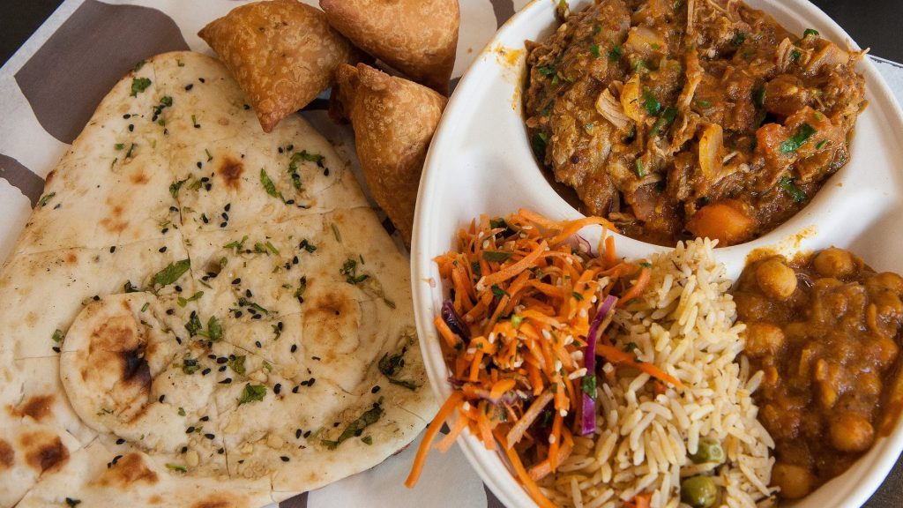
The number game
The number of Indian restaurants in each city is as follows:
New York, NY = 254
Chicago, IL = 168
San Francisco, CA = 156
Jersey City, NJ = 101
Boston, MA = 74
So if you are having a vacation and have time to explore the whole of the city, New York will be the best place to hang around and try different varieties of Indian food, since it has a lot of Indian restaurant options.

Slide 5
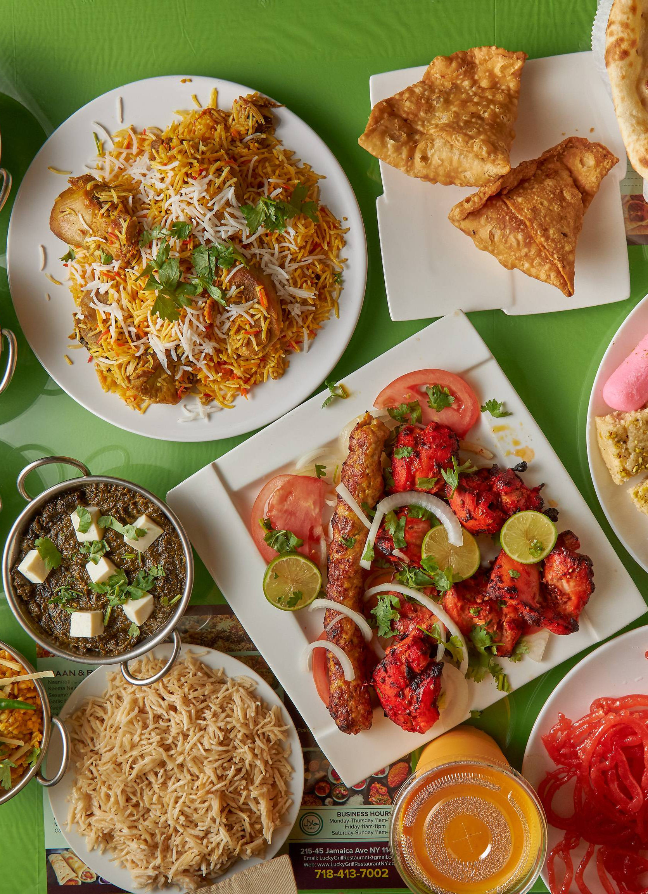
Let’s talk density, shall we?
One more thing to consider in this data is the time a traveller has, to visit a city. If short on time, a person would like to know the city which is densely infused with these flavour-infused restaurants.

Slide 6
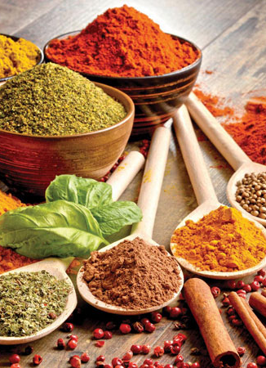
The data science spice
Utilizing the spice that data science provides us, the density of the 5 cities (100 data points) is calculating and printed nicely onto the map of the given city using the Folium API. The next 5 slides will show the images of the 5 cities and their density points on top of their map.

Slide 7
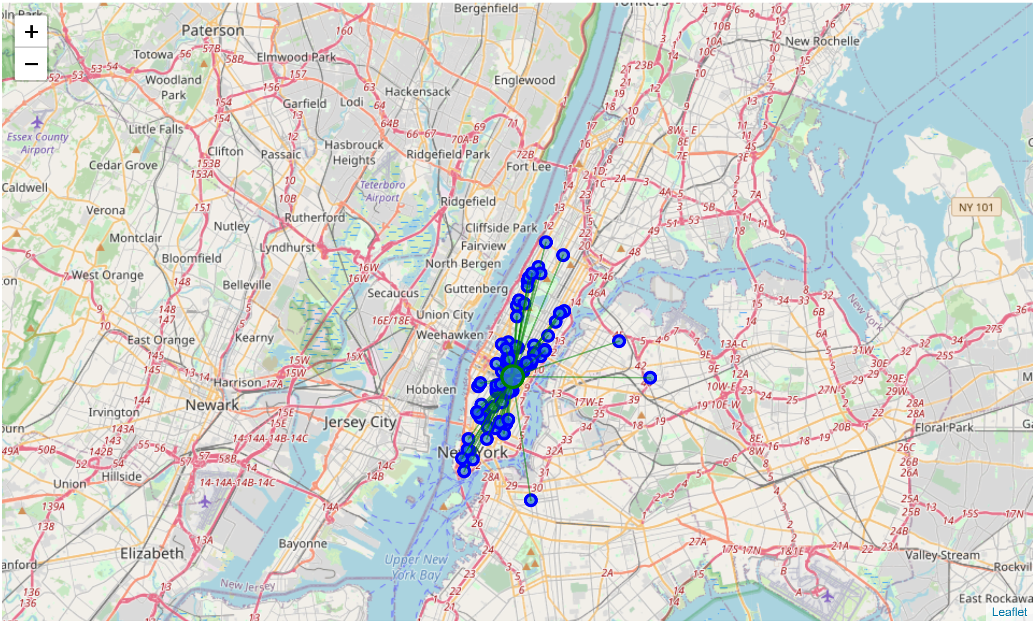
New York, NY

Slide 8
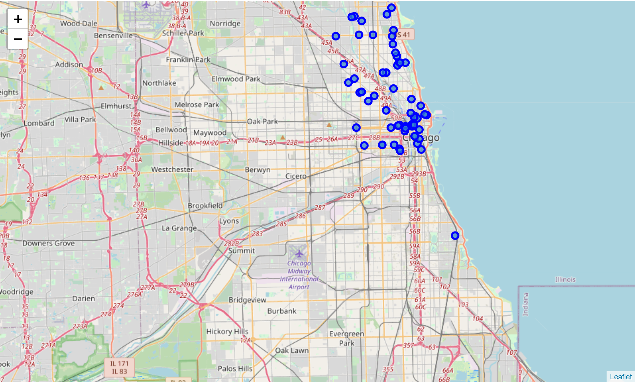
Chicago, IL

Slide 9
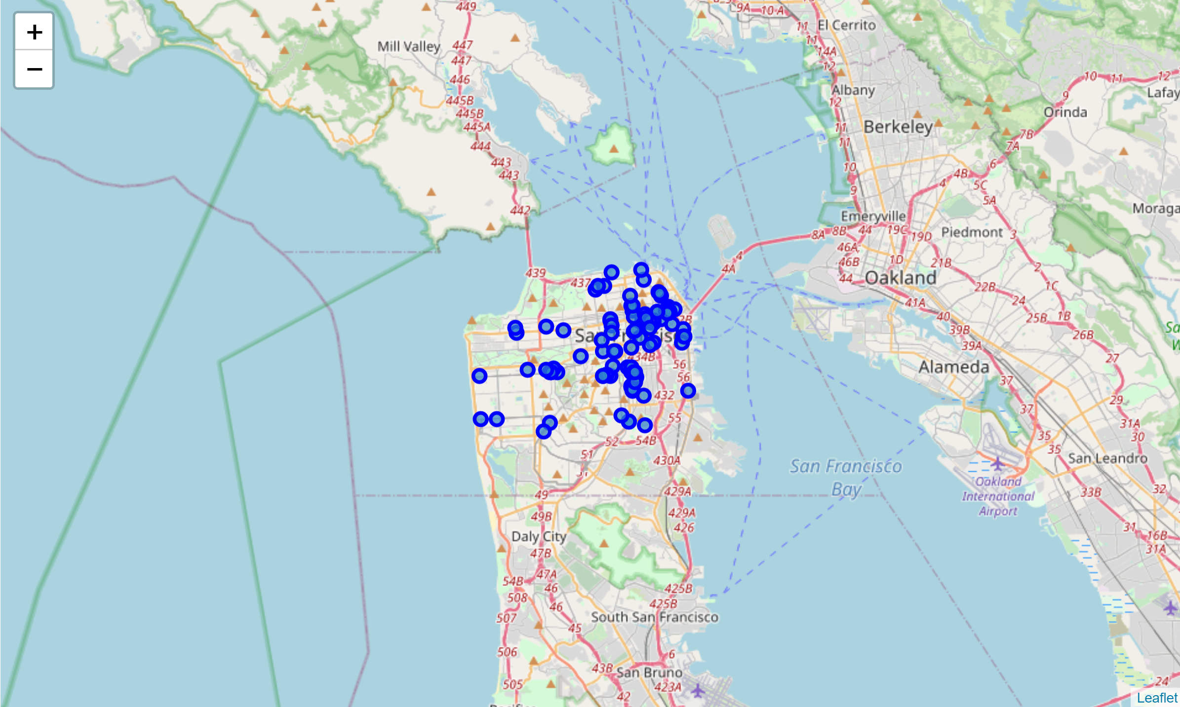
San Francisco, CA

Slide 10
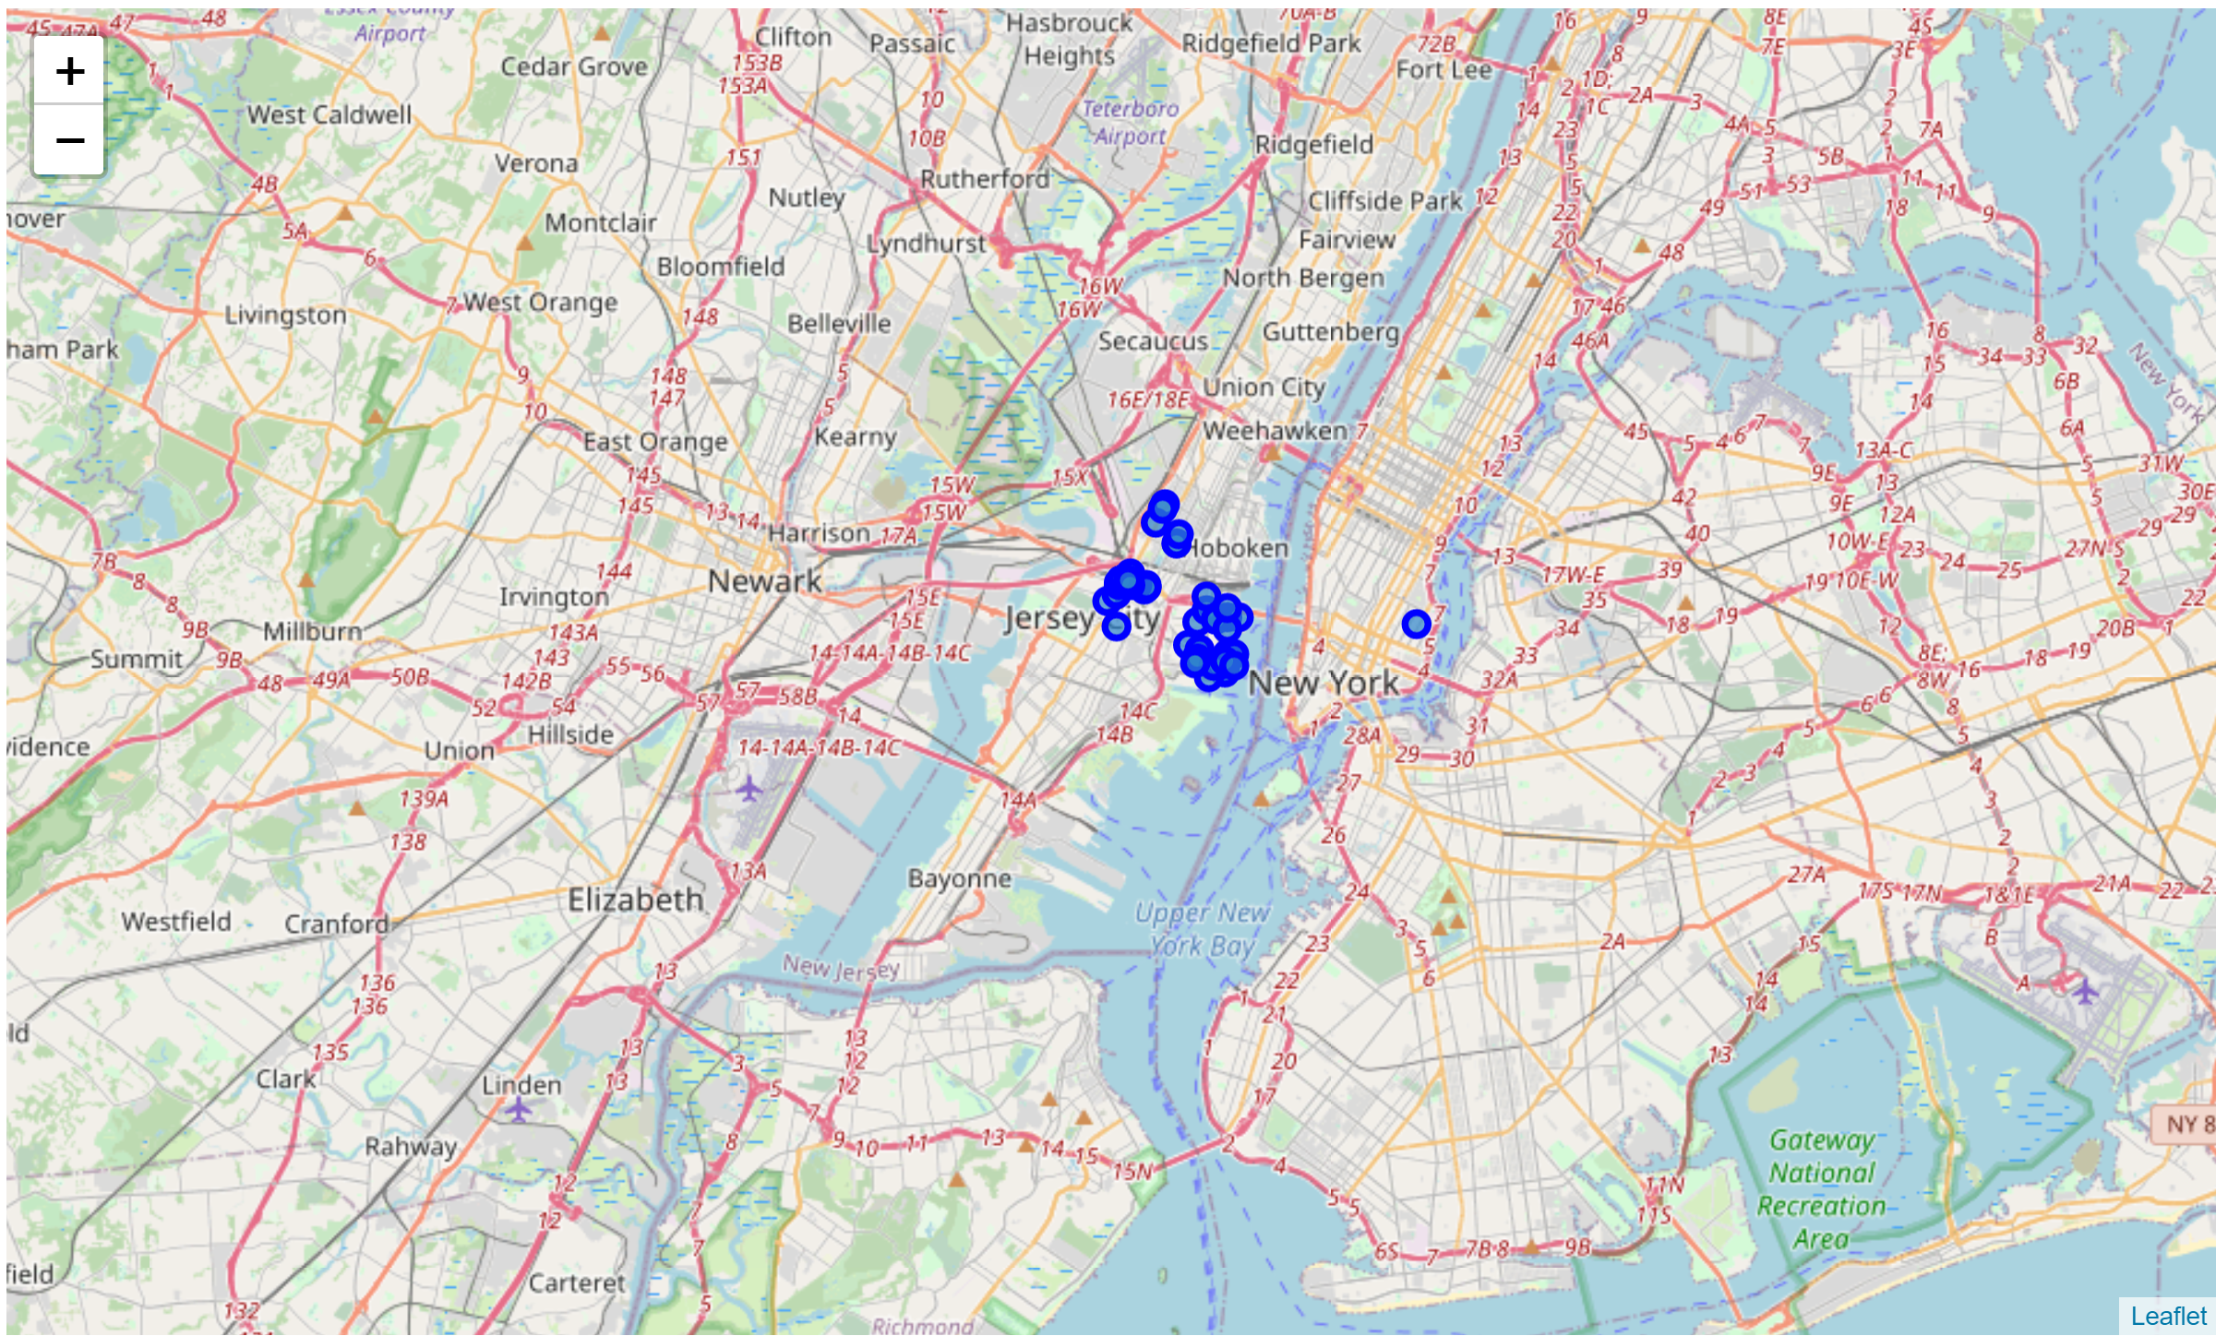
Jersey City, NJ

Slide 11
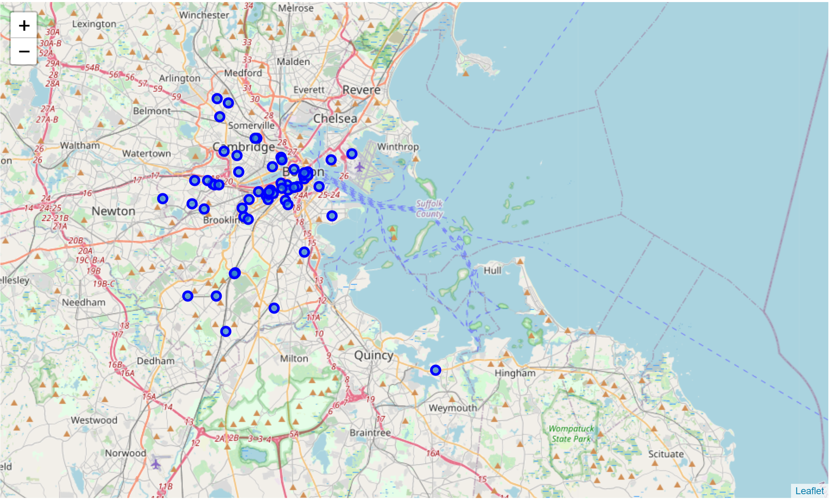
Boston, MA

Slide 12
Why so mean?
Now we calculate the mean point and mean distance from the mean point, to get a feel of which is the densest area in terms of Indian restaurants.
New York, NY - 0.024
Chicago, IL - 0.055
San Francisco, CA - 0.026
Jersey City, NJ - 0.013
Boston, MA - 0.148
The lower the value is the densely packed the restaurants are. As we can see, Jersey City has the most density of Indian restaurants, and Boston has those restaurants at very sparse locations (can be seen from the graph as well)
Yes, I am being mean to you Boston ☺

Slide 13
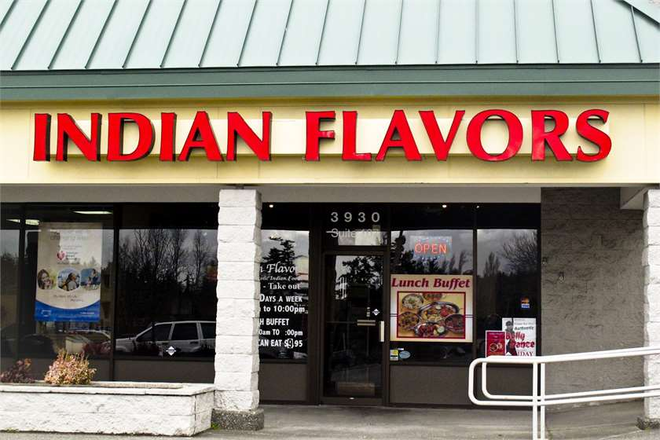
Time to sum it up
This data analysis report can help a tourist or a student or someone interested in Indian food decide which cities to visit for getting good options for the same. The number of restaurants gives an idea of the sort of variety that can be expected in the city with New York having the greatest number of Indian restaurants, followed by Chicago, San Francisco, Jersey City and then Boston. Another thing to consider for tourists that are travelling for a day or so and they'd want restaurants that are close by to choose from (since Indian restaurants also have a lot of sub-categories to go with) so for that the ideal place to go will be Jersey City followed by New York, San Francisco, Chicago, and then Boston.
So in conclusion, Jersey City and New York are the 2 ideal places for a day and a week’s travel respectively. Also, Boston has been the worst performer in both the data metrics, so one would need to roam a lot around the city to get good Indian restaurants there.

Slide 14




Thanks for your attention and “bhojan ka anand lijiye”

